Slide 1


FASHION OUTFIT RECOMMENDATION SYSTEM
Name- Ananya Bhatia(S24CSEU1979)
Aaditri Chandok(S24CSEU1774)
Kashish Kapoor(S24CSEU1764)

Slide 2

Problem Statement
The project focuses on utilizing text-based product data (titles, descriptions, attributes) to personalize outfit suggestions. By analyzing user preferences, fashion categories, and product metadata, the system aims to reduce decision fatigue and help users discover suitable, stylish, and context-appropriate outfits efficiently.

Slide 3
PROPOSED SOLUTION
This project provides a smart, -driven recommendation system that suggests complete fashion outfits instead of single products. Using machine learning on dataset features such as color, category, material, and price, the system identifies compatible clothing items and generates outfit combinations for various occasions. The solution enhances user experience by offering personalized, relevant, and context-aware recommendations based on user interaction data and product descriptions.

Slide 4

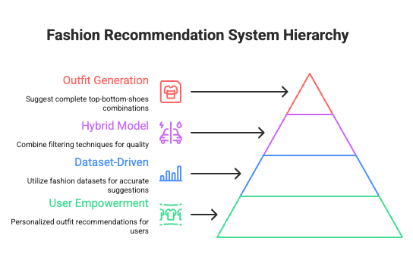


GOALS AND OBJECTIVES
Empowering Users
Diverse Categories
Incorporating AI

Slide 5
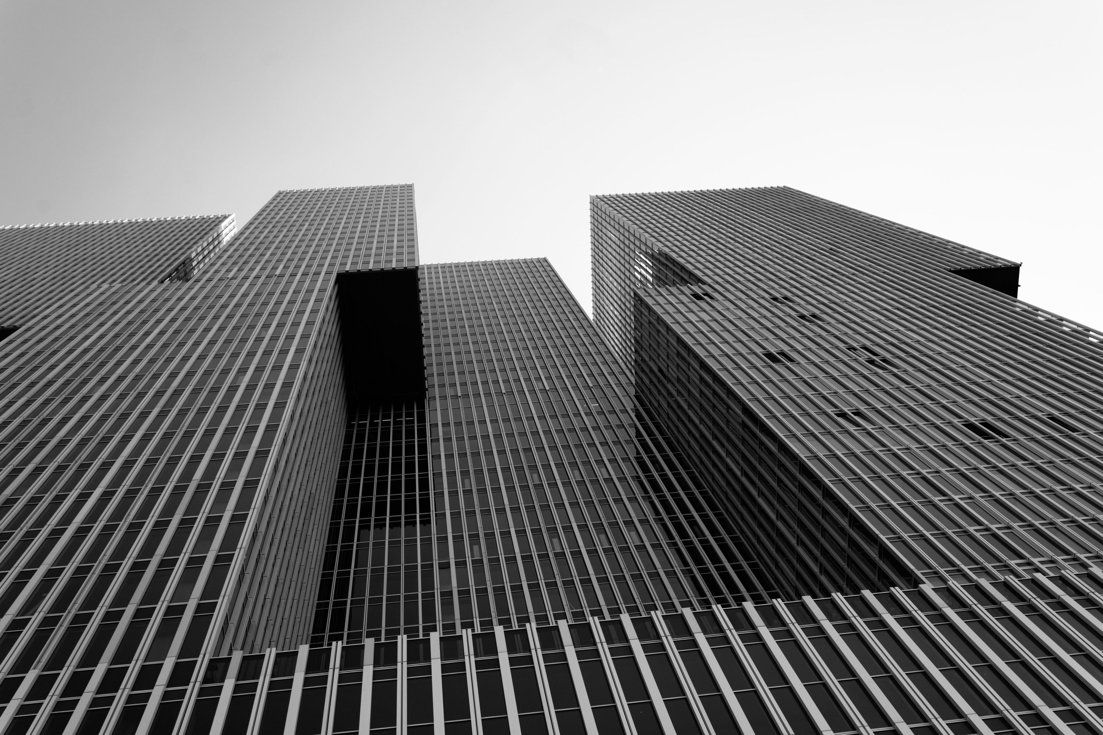

TECHNOLOGY USED
Technologies Used
Language
Python 3
Web Framework
Flask (flask, werkzeug, Jinja2 via Flask)
Auth & Sessions
flask-login
Database & ORM
flask-sqlalchemy (SQLAlchemy)
SQLite (default SQLALCHEMY_DATABASE_URI)
Machine Learning / Data
scikit-learn (TF-IDF, RandomForest, train/test split, metrics)
pandas
numpy
joblib (model persistence)
Similarity & Text Features
sklearn.feature_extraction.text.TfidfVectorizer
sklearn.metrics.pairwise.cosine_similarity
Image Processing (referenced by code and requirements)
Pillow
OpenCV (opencv-python)
Utilities
requests (present in requirements; not explicitly used in the shown files)
werkzeug.utils.secure_filename
Project Structure Helpers
Flask extensions module (
extensions.py
): centralizes db and login_manager

Slide 6
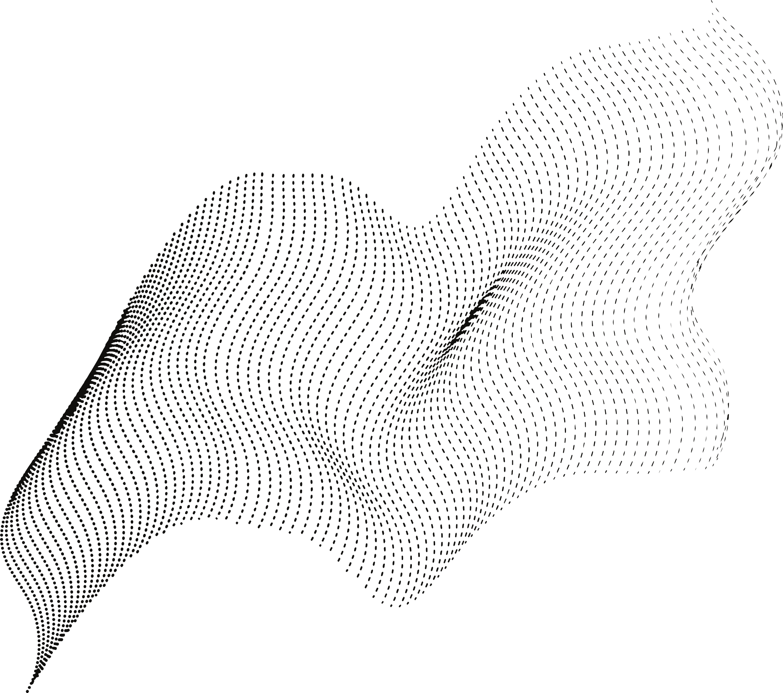
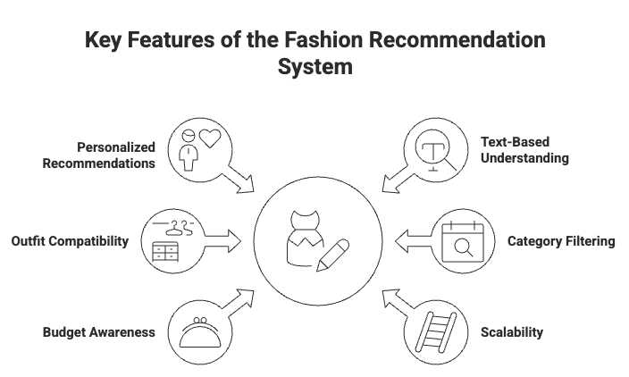

Slide 7
Future
Prospects
:Integration of Image-Based Analysis using CNNs for better visual understanding.
: Development of a mobile app or responsive web UI for real-time recommendations. : Inclusion of weather, seasons, and location-based outfit suggestions.
: Social-media style features: users can like, rate, and share outfits. : Smart stylist chatbot for personalized fashion guidance.

Slide 8
Thank You!

